Slide 1
MMS XLC MMS eXtreme Load Controller
XMMS Asia Support

Slide 2
Content
Introduction to MMS XLC
Objective of MMS XLC data collection
MMS XLC Template
MMS XLC Application and Report Portal

Slide 3
Introduction to MMS XLC
What is MMS XLC?
MMS is the legacy system of Margin Monitoring System that use ORACLE database. XMMS is the newer version that use MS-SQL databse
XLC stand for eXtreme Load Controller
What is MMS XLC in a nut shell?
MMS XLC is a data collection of backend tester data thru file generated by tester Load Controller. It consist of data loading of tester data from backend tester into database
Tester Cell / Slot information
Tester Robot information
Tester information as a whole, software/firmware version, status activity etc
How does MMS XLC work?
MMS XLC generate based on template number – XLC##. MMS XLC Loader setup to load data based on the template number into different set of database tables. Each of the template number is setup with particular number of data fields in delimiter format

Slide 4
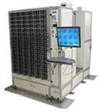
Introduction to MMS XLC
MMS XLC General Process Flow (Identical in WDM \ WDTH)
1
2
3
Backend Testers
XLC Files
File Servers
XLC Files
Cruncher Servers
Archive Files
Archive Servers
Load Controller
Data Loading
Reports…
Reports…
SPOTFIRE…
Data Crunching
Oracle Database
4

Slide 5
Objective of MMS XLC data collection
What is the purpose of MMS XLC?
MMS XLC allows Tester Engineers to understand tester performance and allows visibility into tester attributes data analysis
Main attributes from MMS XLC include
Test Time (Start and End Timestamp) of Tester Slots
Tested Operation of Tester Slots
Tested Drive information from Tester
Tester Slots inventory
Tester System Status by Timestamp
Tester firmware / software version
The MMS XLC data is presented to user thru Web Application and MS-SQL Reporting Services. XMMS team develop the apps and reports as well as data crunching to provide timely / aggregated / simplify data to user
SPOTFIRE has been use as a data analytics tool for MMS XLC data

Slide 6
Objective of MMS XLC data collection
Who are MMS XLC data user and what are they looking at?
MMS XLC Data User
Test Equipment Engineering
Test Development Engineering
Product Engineering
Industrial Engineering / Manufacturing
Global Service Center
MMS XLC Data Usage
Tester Test Time / Utilization by Tester / Slots
Product Operation Test Time
Tester Drive Inventory
Tester Software / Firmware information

Slide 7
MMS XLC Template
MMS XLC list of template and tables (Q316 update)
MMS XLC
XLC NO | MMS XLC TABLE NAME
XLC22 | X_TESTER_LD_DIST
XLC23 | X_SYSTEM_STATUS
XLC26 | X_CELL_REPAIR
XLC30 | X_CELL_STATUS
XLC31 | X_TEST_UTILIZATION
XLC34 | X_STAT_TESTER
XLC35 | X_I_RADAR
XLC36
XLC37 | X_I_OPTIMUS
XLC38
XLC41 | XUT_PARAM

Slide 8
MMS XLC Template
MMS XLC list of template and tables (Q316 update)
MMS XLC
XLC NO | MMS XLC TABLE NAME
XLC43 | X_DTU_STATUS
XLC44 | X_DTU_CYCLE_TIME
XLC45 | X_DRIVE_MODEL_QTY
XLC46 | XUT_TRAY_CNT
XLC50
XLC59
XLC48 | X_DRIVE_MOVEMENT
XLC49 | X_AUTOMATION_LOADING
XLC51 | X_TESTCASE_TIME
XLC55
XLC52 | X_TRACE_DRIVE

Slide 9
MMS XLC Template
MMS XLC list of template and tables (Q316 update)
MMS XLC
XLC NO | MMS XLC TABLE NAME
XLC54 | X_AUTOMATION_DOWNTIME
XLC57 | X_TESTER_VERSION_INFO
XLC58 | X_CELL_STATES_INFO
XLC60 | X_SLOT_DOWNTIME
XMM2 | X_MITECS_STAT
XMH1 | X_XMH_CLIENT
XSCC01 | XSCC_VERSION_INFO
XSU01 | XSU_VERSION_INFO

Slide 10
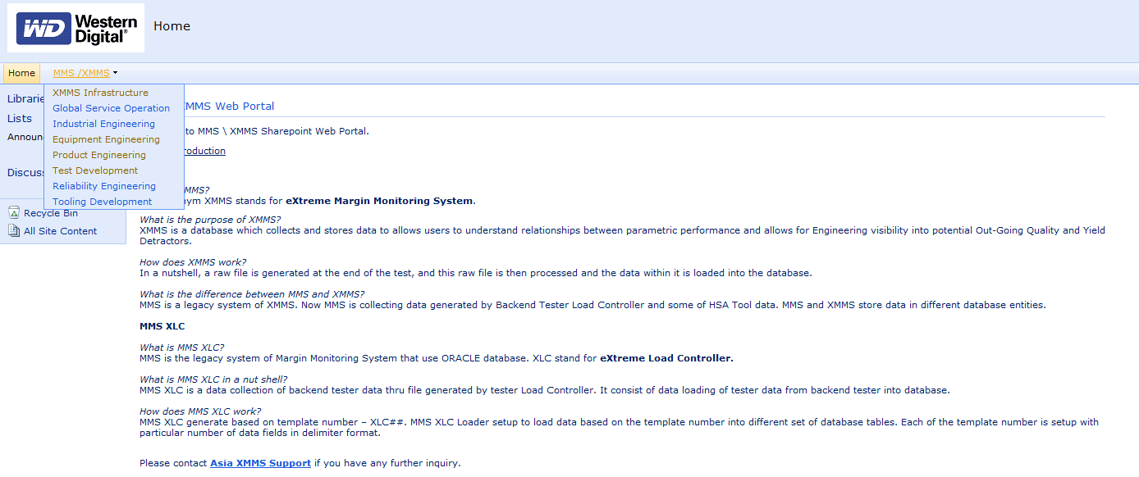
MMS XLC Application and Reports Portal
MMS – XMMS Web Portal
MMS – XMMS setup it application and report web portal in WD-Legacy SharePoint
http://asianet.my.asia.wdc.com/dept/IT/XMMS/WebPortal/default.aspx
It consist application and report from XMMS, MITECS and MMS-XLC source
Menu segregate by Engineering Department

Slide 11



